Slide 1

Diffusion Crystal Formation
By Andrew Dunne

Slide 2

Brainstorming
Mineral dendrites
Human tissue
Blood dropping onto wet floor
Tree/plant growth in blender?
Growth of social media accounts, based on network graphs and force attractors
Spread of fire, consuming a human arm
Crystallization… maybe scientific, or land of the lustrous? Could have something to do with music
‘Universe zoom’: attached sections may be attached on one level, but floating on another.

Slide 3
How to Simulate Crystal Formation
Crystalline molecule structures form when atoms in a chaotic space attach to each other in an optimal configuration - sound familiar? Just like the given simulation! (with a few more physical characteristics too I’m sure). After watching a neat TED-ed video on the topic, I decided to alter the simulation so that it would create a 2D version of a cubic crystal, like diamonds.
To do this, I replaced the random movement of the particles with orthogonal movement instead, which gave much more predictable results. More tinkering led to square-shaped crystals among others, but it’s really dependent on the initial noise conditions. I like to think this is similar to how diamonds form, because they form cubically at lower temperatures and octahedron-shaped at higher temperatures.

Slide 4
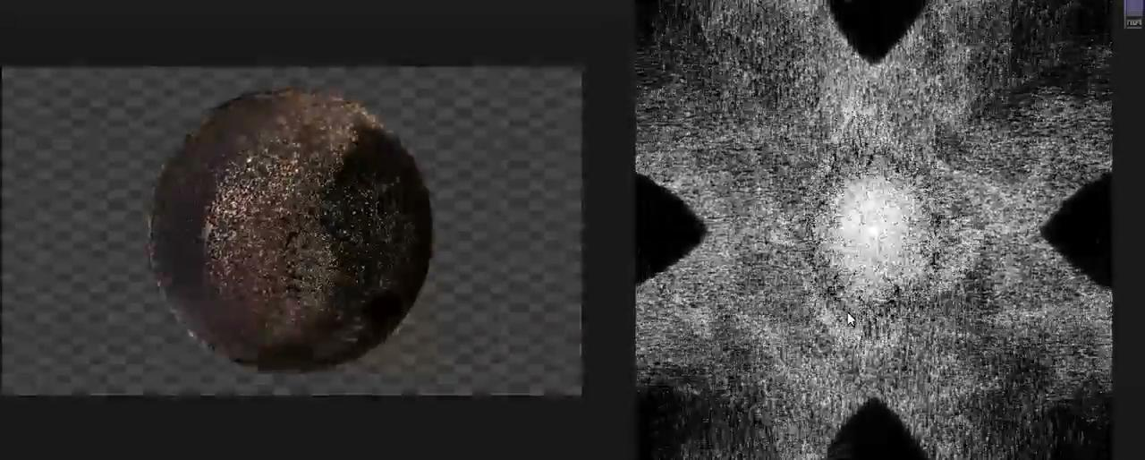

Slide 5
Link
https://github.com/AndrewDunne/CMPM169Projects/tree/main/Proj5

Slide 6
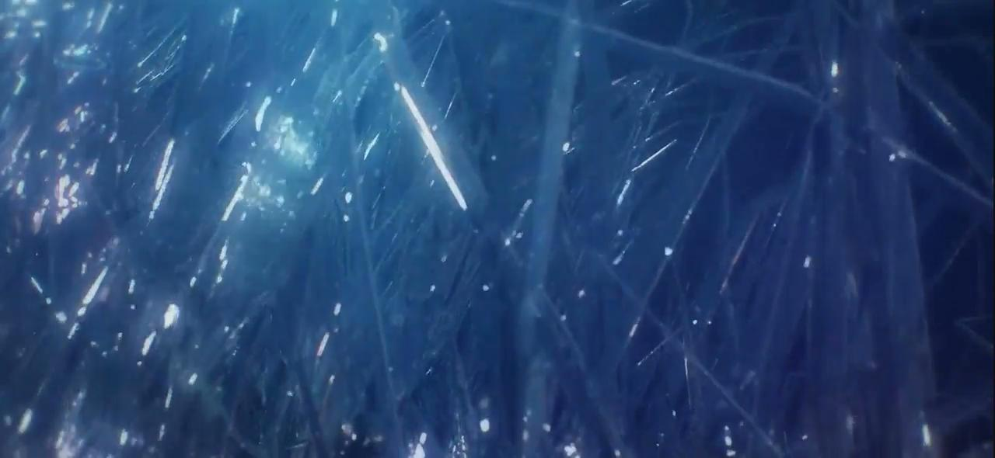
Sources, research, and goodies
The aforementioned ted-ed video by Graham Baird and Franz Palomares
Crystallization on wikipedia
HDRI environment light from HDRIHaven
A clip from my fav anime which was inspiration:

